Slide 1

CIS016-1 – Principles of Programming 2021-2022 Assignment 2 – Hotel Online Customer Booking and Management System
University ID :2146504
Full Name: Baibhav Paudel

Slide 2
Introduction
Hotel Luton desktop application for online hotel booking and management system.
System that allows customer to register and create an account with their details.
Customer needs to log in to book, view, change or cancel upcoming booking.
Matching the customer’s demand receptionist can assign room to the booking.

Slide 3
Object Oriented Programming
Object Oriented Programming model.
Flow of program step by step through N-tier architecture

Slide 4
Description
Client signup to Luton application.
Login after signing up.
Can view booking details and payment details from profile.
Can place a booking from user homepage.

Slide 5
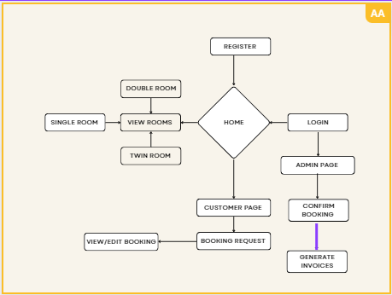
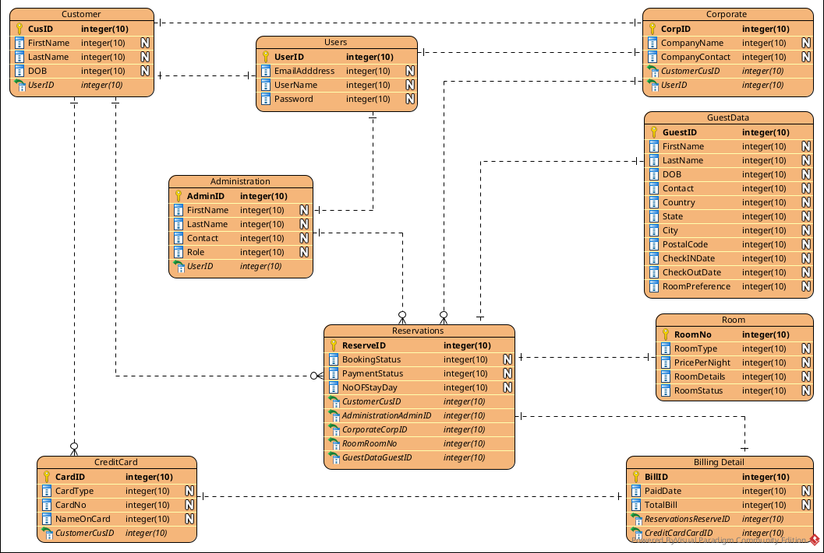
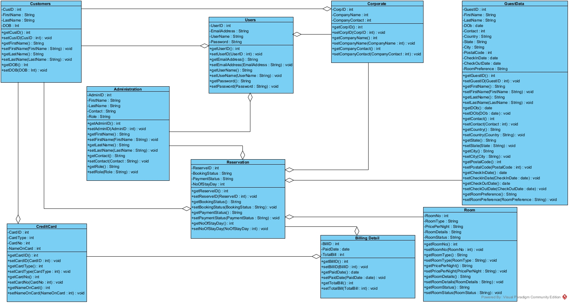
Design and Implementation
Eclipse IDE window builder for GUI design.
MySQL DBS as database system.
For class , use case and activity diagram were designed using Visual paradigm.
Prototype using Balsamiq Wireframe

Slide 6
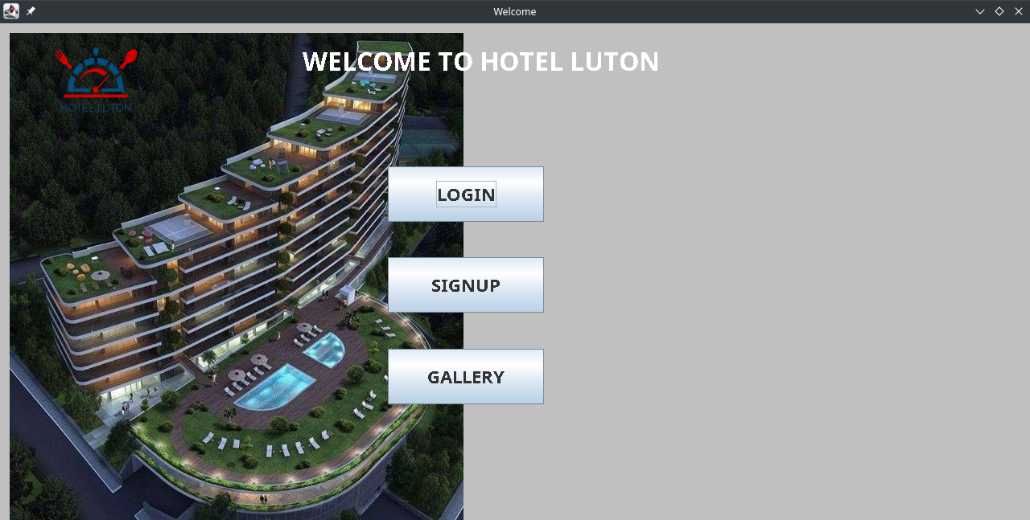
Conclusion
User friendly GUI was created.
OOP concept was implemented.
MySQL DBMS was successfully connected for application data storing.
All requirement were met

